Slide 1
Causality
Understanding Machine Learning
October 2022
Felix Wick

Slide 2
Data-Generating Process
story behind the data as important as the data itself
Why are the statistical dependencies as observed?
data-generating process mostly governed by causal dependencies
but language of algebra symmetric
no way to tell that a storm causes barometer to go down and not the other way around → need for asymmetric mathematical language

Slide 3
Levels of Causal Modeling
physical or deterministic models:
described by differential equations
needs somebody to come up with
causal models:
described by probabilities with causal structure
learned from data with causal assumptions
statistical models (including ML):
described by probabilities
can be learned from data

Slide 4
Probabilistic and Causal Models
probabilistic inference
probabilistic model
observations
statistical learning
subsumes
subsumes
causal inference
observations &
interventions &
imagination
causal model
causal discovery
from Elements of Causal Inference (Peters, Janzing, Schölkopf)

Slide 5
Causality and ML
causation as addition to ML: synonym for understanding
no ML method can understand causes and effects from data (statistical dependencies) alone → need for causal assumptions (causal model)
examples: transportability and robustness of models (generalization), handling of missing data, causal explainability
(see Pearl and Schölkopf 1 2 3)
but also: ML as help for causal discovery and inference
counterfactuls (potential outcomes) need matching of individual cases
adjusting for many confounders (e.g., propensity scores)

Slide 6
Graphical Models

Slide 7
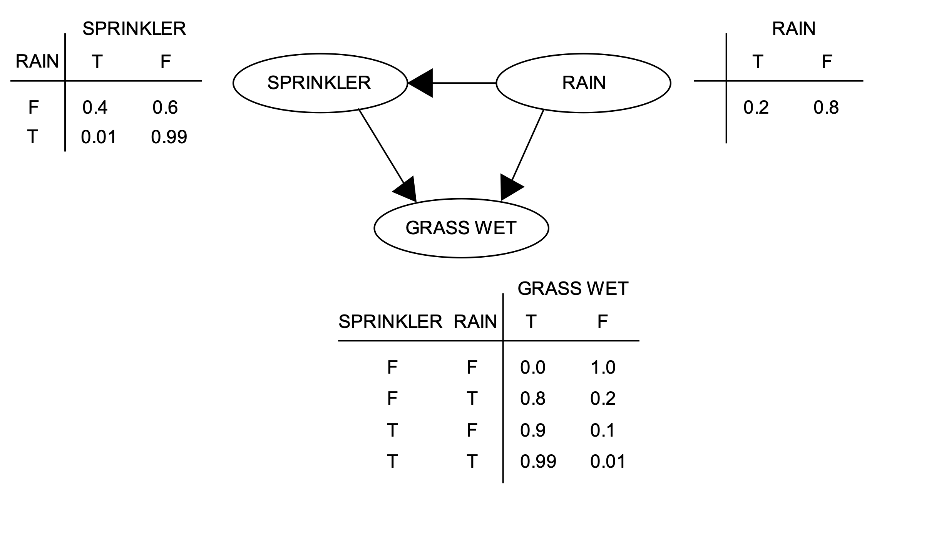
Probabilistic Graphical Model
Directed Acyclic Graph (DAG): random variables (nodes) and their (conditional) dependencies (edges)
Bayesian network: DAG with updates on new evidence according to Bayes’ rule (belief propagation)
message from parent to child: update using conditional probabilities
message from child to parent: update by multiplication with likelihood ratio
from wikipedia

Slide 8
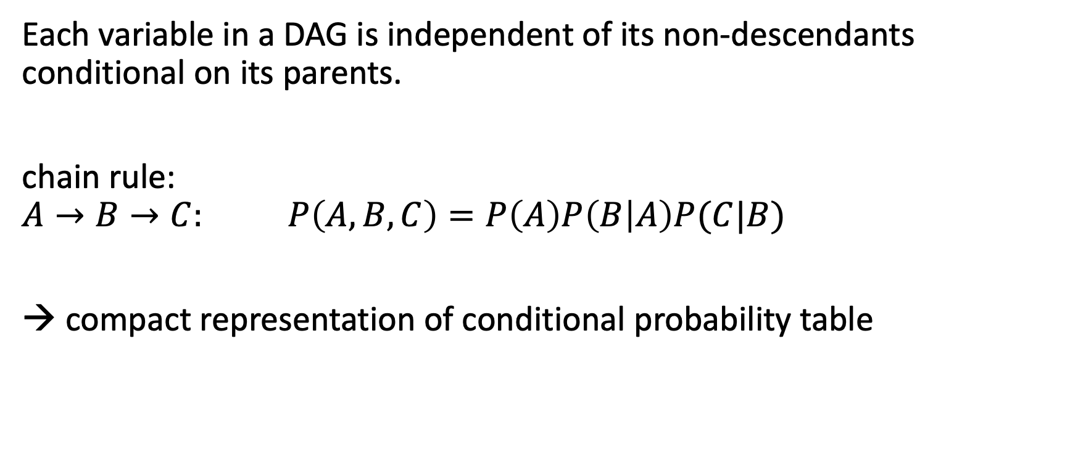
Markov Property
Each variable in a DAG is independent of its non-descendants conditional on its parents.
chain rule:
$$A→B→C: P\left(A,B,C\right)=P\left(A\right)P\left(B | A\right)P(C|B)$$
→ compact representation of conditional probability table

Slide 9
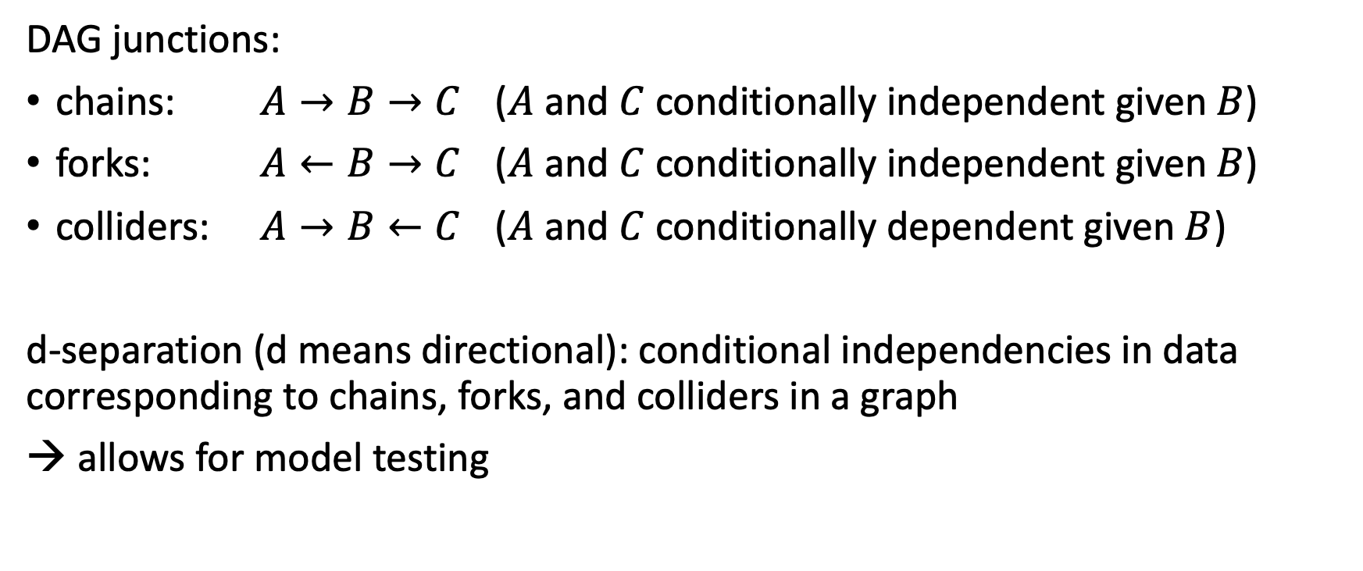
Conditional Independencies
DAG junctions:
chains: $A→B→C$ ($A$ and $C$ conditionally independent given $B$)
forks: $A←B→C$ ($A$ and $C$ conditionally independent given $B$)
colliders: $A→B←C$ ($A$ and $C$ conditionally dependent given $B$)
d-separation (d means directional): conditional independencies in data corresponding to chains, forks, and colliders in a graph
→ allows for model testing

Slide 10
Toward Causal Diagrams
load graph with causal assumptions (model)
→ arrows give direction of cause-effect relationships
causal Markov property: Each variable in a causal graph is probabilistically independent of its non-effects conditional on its direct causes.
causal models (represented by graphs) allow to answer interventional and counterfactual (fictional) queries
often even without conducting experiments

Slide 11
Causal Inference

Slide 12
The Ladder of Causation
III imagining counterfactuals What if I had done ...? Why?
II doing intervention What if I do ...? How?
I seeing association What if I see ...? → Realm of ML
from The Book of Why (Pearl, MacKenzie)

Slide 13
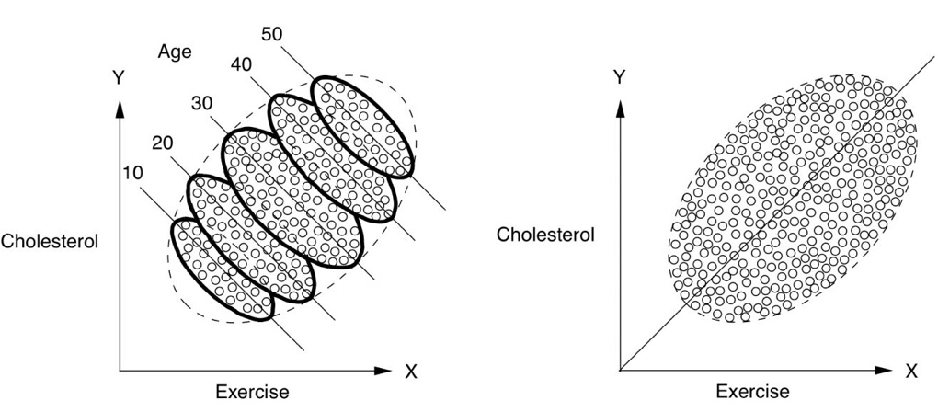
Simpson’s Paradox
exercising good for all age groups but bad overall?
from The Book of Why (Pearl, MacKenzie)

Slide 14

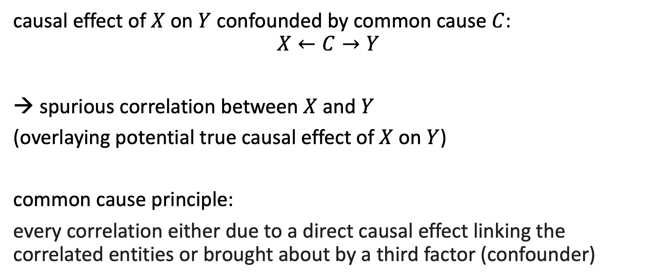
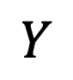
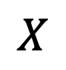
Confounding
causal effect of $X$ on $Y$ confounded by common cause $C$:
$$X←C→Y$$
spurious correlation between $X$ and $Y$
(overlaying potential true causal effect of $X$ on $Y$)
common cause principle:
every correlation either due to a direct causal effect linking the correlated entities or brought about by a third factor (confounder)
$$C$$
$$X$$
$$Y$$

Slide 15
Example: Pricing in Retail
price setting for a product can be considered a demand shaping method
the idea is a causal effect: lower price leads to higher demand
→ by estimating this causal effect one can find an optimal price according to a given policy (like maximizing profit)
problem: confounders influencing both pricing in past (obverved) data and demand, e.g., lowering prices on weekends only for grocery or lowering prices toward end of a season for fashion

Slide 16
Example: Temporal Confounding
forecasting of times series can rely on endogenous (past values of the time series to forecast in the future) or exogenous (other variables) information
endogenous information means auto-correlation
auto-correlation often spurious (temporal confounding, e.g., common causes at consecutive times), i.e., no direct causal effects
most state-of-the-art forecasting methods rely mainly on endogenous information, i.e., temporal confounding
but learning of direct causal effects from exogenous information offers several advantages, like explainability, long-term forecasting, predictability of rare events
one simple possible solution: no use of target autocorrelation in (quasi-causal) ML model, but subsequent residual correction

Slide 17
Interventions
aim:
prediction of (average) causal effect of (yet untried) actions (interventions)
two ways:
intervene via randomized controlled trials (RCT): set action randomly and check effect → physically disassociate cause from confounders
causal model: emulating interventions by smart calculations → predict effects of potential interventions from observational studies only, i.e., without experiment)

Slide 18
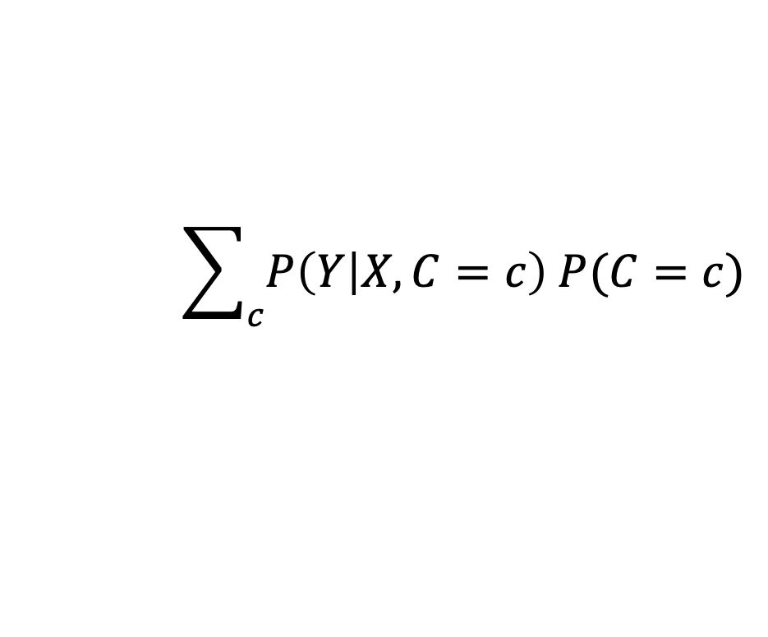
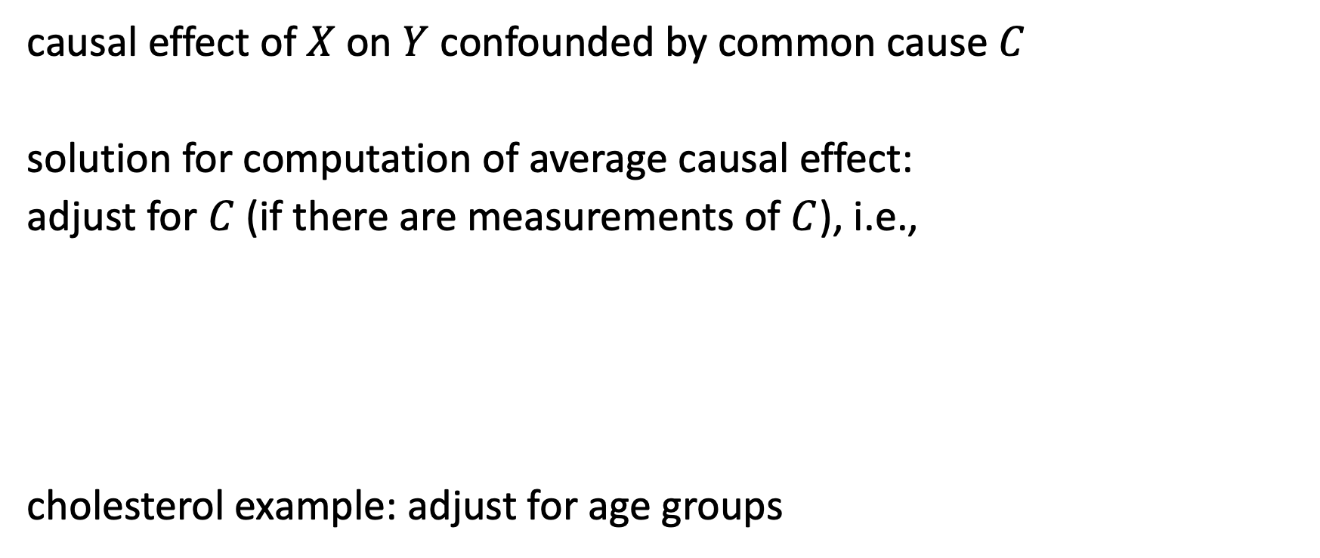
Solution for Average Causal Effects
causal effect of $X$ on $Y$ confounded by common cause $C$
solution for computation of average causal effect:
adjust for $C$ (if there are measurements of $C$), i.e.,
cholesterol example: adjust for age groups
$$C$$
$$\sum_{c}{P\left(Y | X,C=c\right) P(C=c)}$$
$$X$$
$$Y$$

Slide 19






Not to Adjust for …
$$X$$
$$Y$$
colliders
correlation without causation
exception to common cause principle
selection bias
mediators
mechanism of effects: why?
direct and indirect effects
need for counterfactual description
$$Z$$
$$M$$
$$X$$
$$Y$$

Slide 20
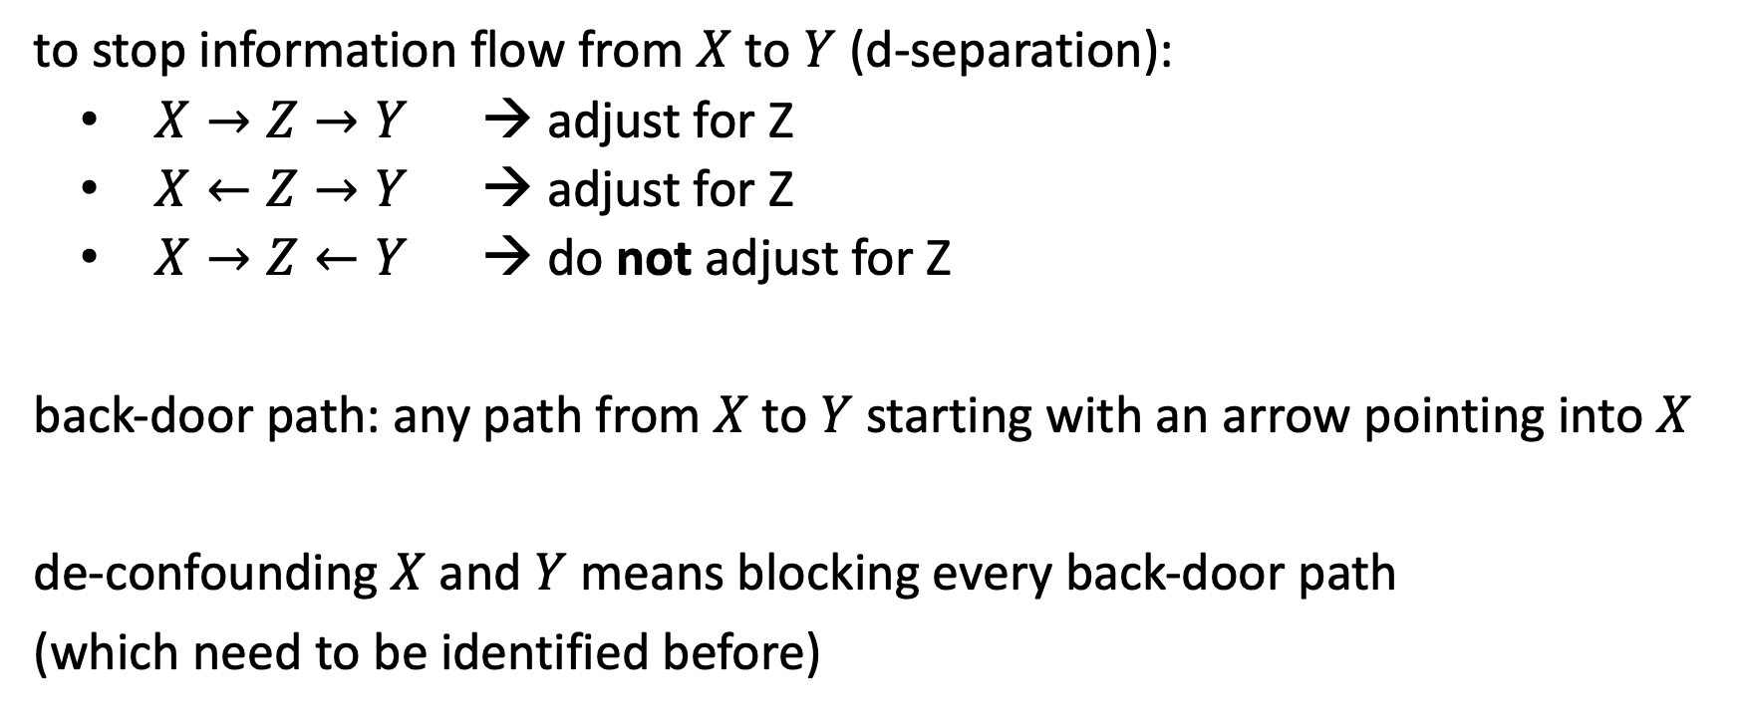
Back-Door Criterion
to stop information flow from $X$ to $Y$ (d-separation):
$X→Z→Y$ → adjust for Z
$X←Z→Y$ → adjust for Z
$X→Z←Y$ → do not adjust for Z
back-door path: any path from $X$ to $Y$ starting with an arrow pointing into $X$
de-confounding $X$ and $Y$ means blocking every back-door path
(which need to be identified before)

Slide 21
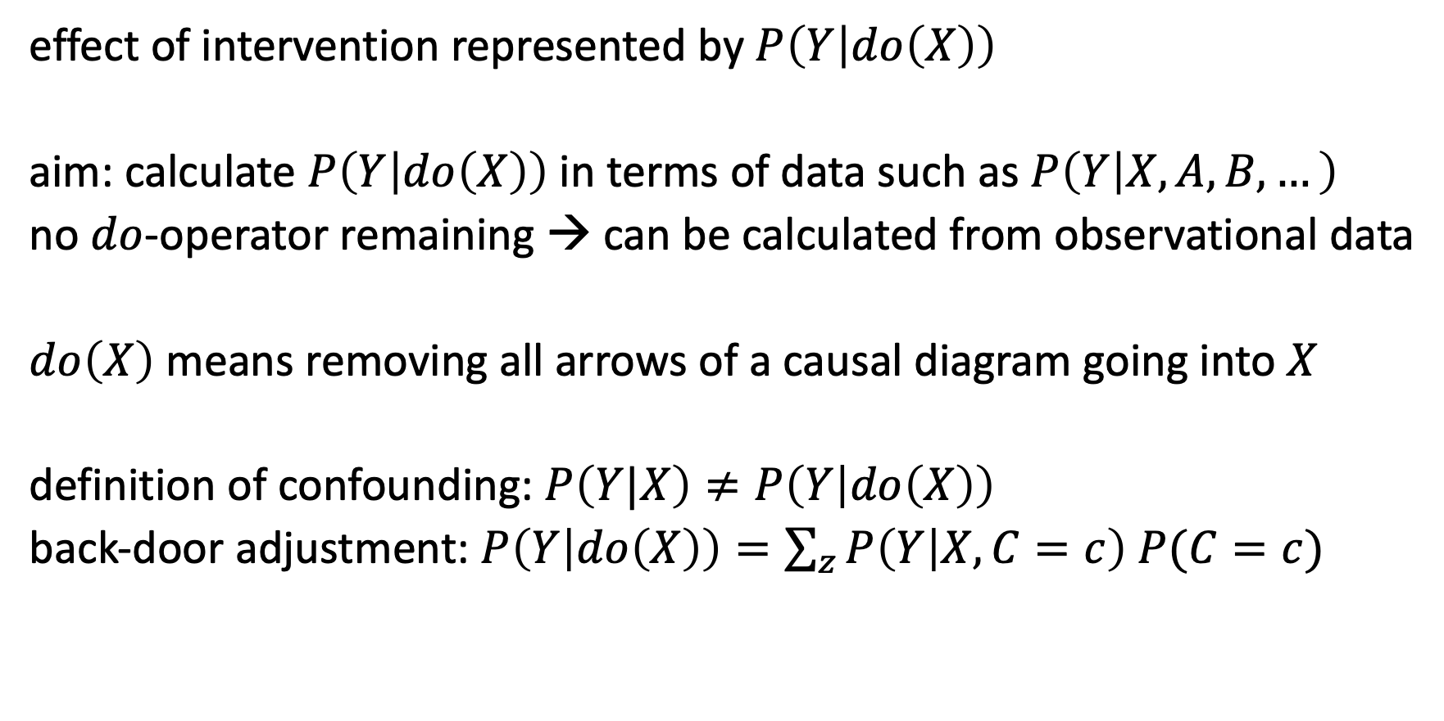

$do$-Calculus
effect of intervention represented by $P\left(Y | do\left(X\right)\right)$
aim: calculate $P\left(Y | do\left(X\right)\right)$ in terms of data such as $P\left(Y | X,A,B,…\right)$
no $do$-operator remaining → can be calculated from observational data
$do\left(X\right)$ means removing all arrows of a causal diagram going into $X$
definition of confounding: $P\left(Y|X\right)≠P\left(Y | do\left(X\right)\right)$
back-door adjustment: $P\left(Y | do\left(X\right)\right)=\sum_{z}{P\left(Y | X,C=c\right) P(C=c)}$

Slide 22
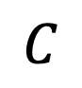
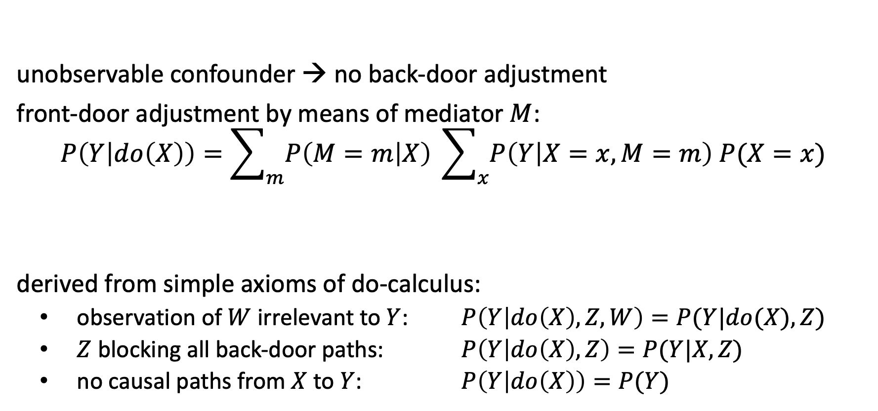
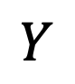


Front-Door Criterion
$$C$$
unobservable confounder → no back-door adjustment
front-door adjustment by means of mediator $M$:
$$P\left(Y | do\left(X\right)\right)=\sum_{m}{P\left(M=m | X\right)} \sum_{x}{P\left(Y | X=x,M=m\right) P(X=x)}$$
derived from simple axioms of do-calculus:
observation of $W$ irrelevant to $Y$: $P\left(Y | do\left(X\right),Z,W\right)=P(Y|do(X),Z)$
$Z$ blocking all back-door paths: $P\left(Y | do\left(X\right),Z\right)=P(Y|X,Z)$
no causal paths from $X$ to $Y$: $P\left(Y | do\left(X\right)\right)=P(Y)$
$$X$$
$$M$$
$$Y$$
adjust for two variables: M and X

Slide 23
Individual Causal Effects

Slide 24
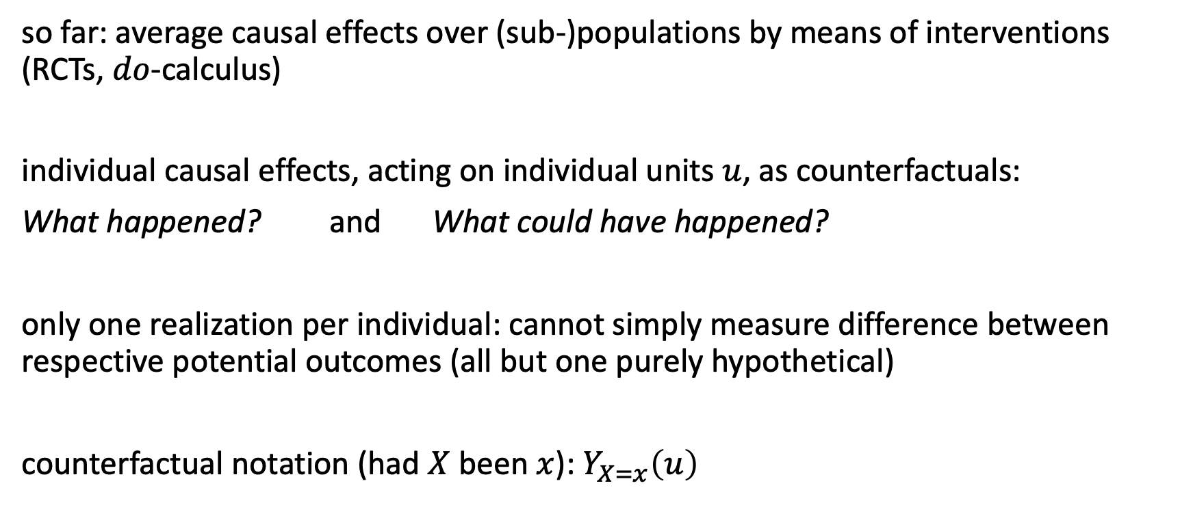
Counterfactuals
so far: average causal effects over (sub-)populations by means of interventions (RCTs, $do$-calculus)
individual causal effects, acting on individual units $u$, as counterfactuals:
What happened? and What could have happened?
only one realization per individual: cannot simply measure difference between respective potential outcomes (all but one purely hypothetical)
counterfactual notation (had $X$ been $x$): $Y_{X=x}\left(u\right)$

Slide 25
Estimation of Individual Causal Effects
impossible to correctly estimate individual causal effects by means of statistical interpolation techniques (impute missing data of potential outcomes)
→ need for additional causal assumptions (a causal model)
two different approaches:
structural causal models (Pearl): guided by causal graph and response functions
Rubin causal model (potential outcomes): guided by structural assumptions (e.g., the need for adjusting for all confounders)

Slide 26
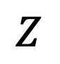
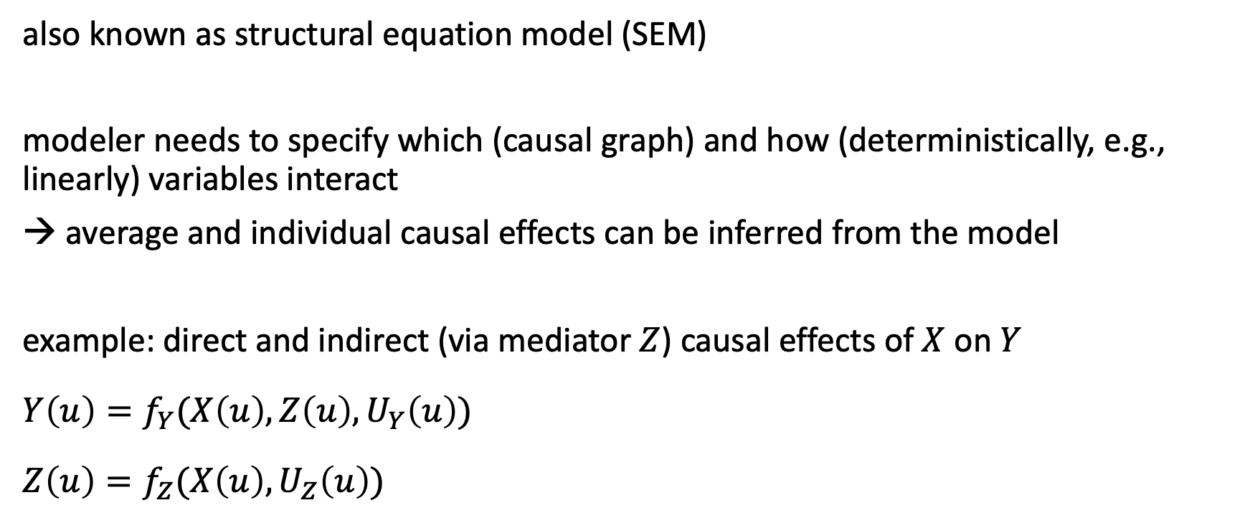
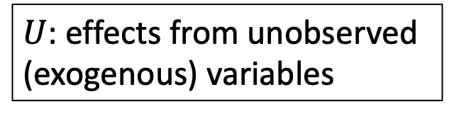


Structural Causal Models (SCM)
also known as structural equation model (SEM)
modeler needs to specify which (causal graph) and how (deterministically, e.g., linearly) variables interact
→ average and individual causal effects can be inferred from the model
example: direct and indirect (via mediator $Z$) causal effects of $X$ on $Y$
$$Y\left(u\right)=f_{Y}(X\left(u\right),Z\left(u\right),U_{Y}\left(u\right))$$
$$Z\left(u\right)=f_{Z}(X\left(u\right),U_{Z}\left(u\right))$$
$$Z$$
$U$: effects from unobserved (exogenous) variables
$$X$$
$$Y$$

Slide 27
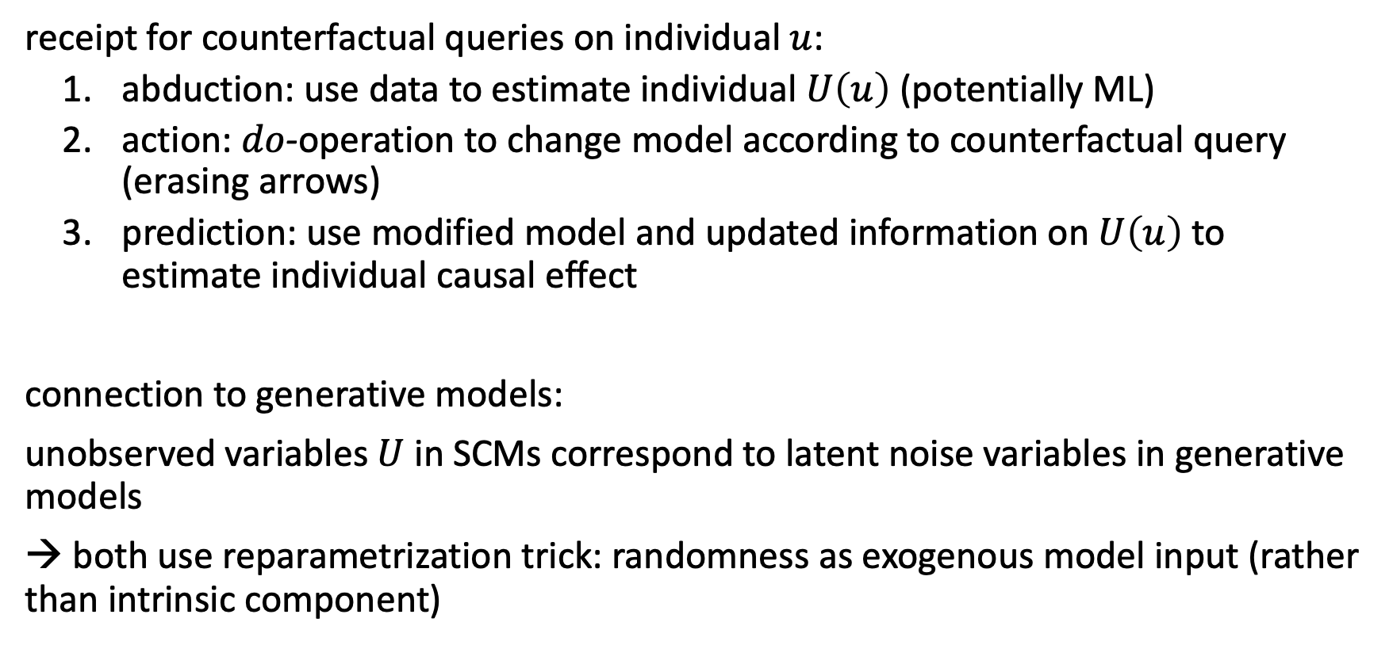
Counterfactual Queries in SCM
receipt for counterfactual queries on individual $u$:
abduction: use data to estimate individual $U\left(u\right)$ (potentially ML)
action: $do$-operation to change model according to counterfactual query (erasing arrows)
prediction: use modified model and updated information on $U\left(u\right)$ to estimate individual causal effect
connection to generative models:
unobserved variables $U$ in SCMs correspond to latent noise variables in generative models
→ both use reparametrization trick: randomness as exogenous model input (rather than intrinsic component)

Slide 28
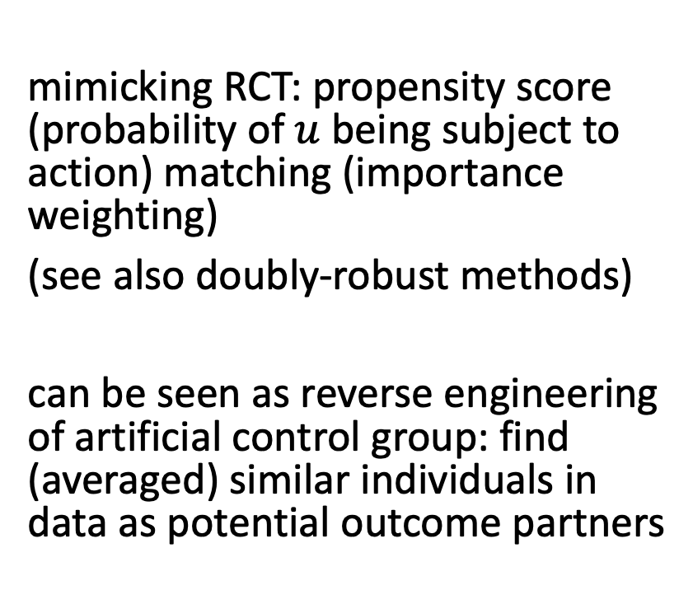
Potential Outcomes with ML
deconfounding
by RCTs or
independence weights (inverse propensity scores)
prediction of individual causal effect with ML model (generalization by function approximation)
mimicking RCT: propensity score (probability of $u$ being subject to action) matching (importance weighting)
(see also doubly-robust methods)
can be seen as reverse engineering of artificial control group: find (averaged) similar individuals in data as potential outcome partners

Slide 29
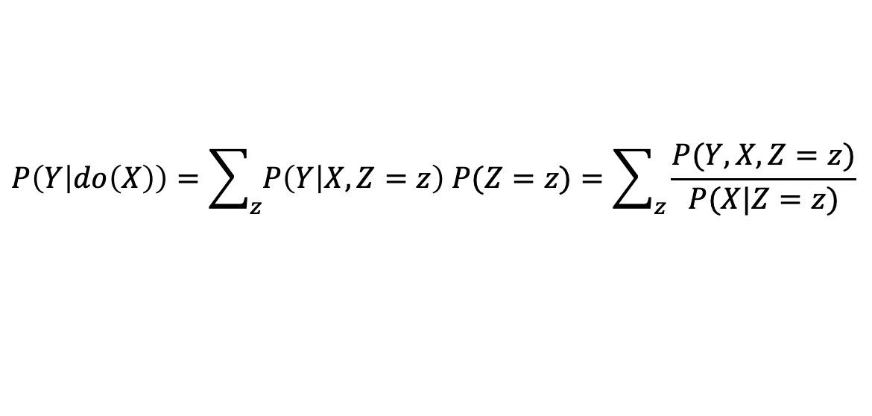
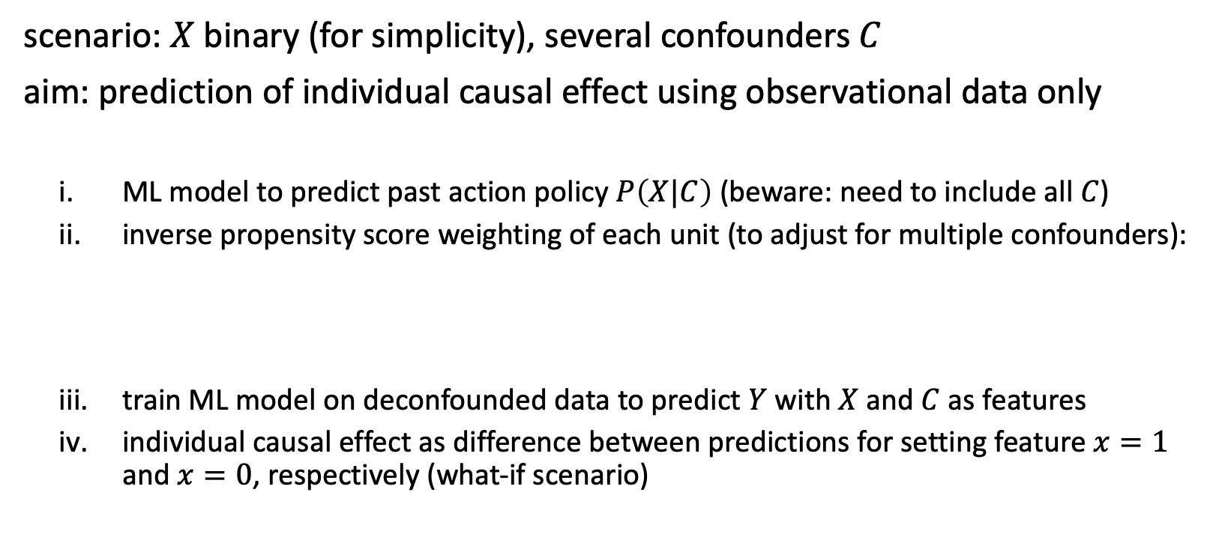
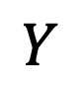

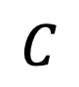
Independence Weights with ML
$$C$$
$$X$$
$$Y$$
scenario: $X$ binary (for simplicity), several confounders $C$
aim: prediction of individual causal effect using observational data only
ML model to predict past action policy $P\left(X|C\right)$ (beware: need to include all $C$)
inverse propensity score weighting of each unit (to adjust for multiple confounders):
train ML model on deconfounded data to predict $Y$ with $X$ and $C$ as features
individual causal effect as difference between predictions for setting feature $x=1$ and $x=0$, respectively (what-if scenario)
alternative:
A/B test
$$P\left(Y | do\left(X\right)\right)=\sum_{z}{P\left(Y | X,Z=z\right) P(Z=z)}=\sum_{z}{\frac{P(Y,X,Z=z)}{P(X|Z=z)}}$$

Slide 30
Causal Discovery

Slide 31
Causal Discovery from Observations
conditional independence testing can reveal aspects of causal graphs by means of observed statistical dependencies
subject to causal Markov property and causal faithfulness assumption: conditional independence only between d-separated variables in a DAG
hard for finite data sets without additional assumptions
→ need for approximative methods

Slide 32
Causal Discovery Methods
causal Bayesian networks: estimating relationships between all variables without the need to specify interactions before (like in SEMs)
restriction of function classes (e.g., smoothness): breaking cause-effect symmetry (e.g., by means of additive noise model)
meta-learning of causal structure based on speed of adaption to modified distributions (Bengio)

Slide 33
Graph Neural Networks (GNN)

Slide 34
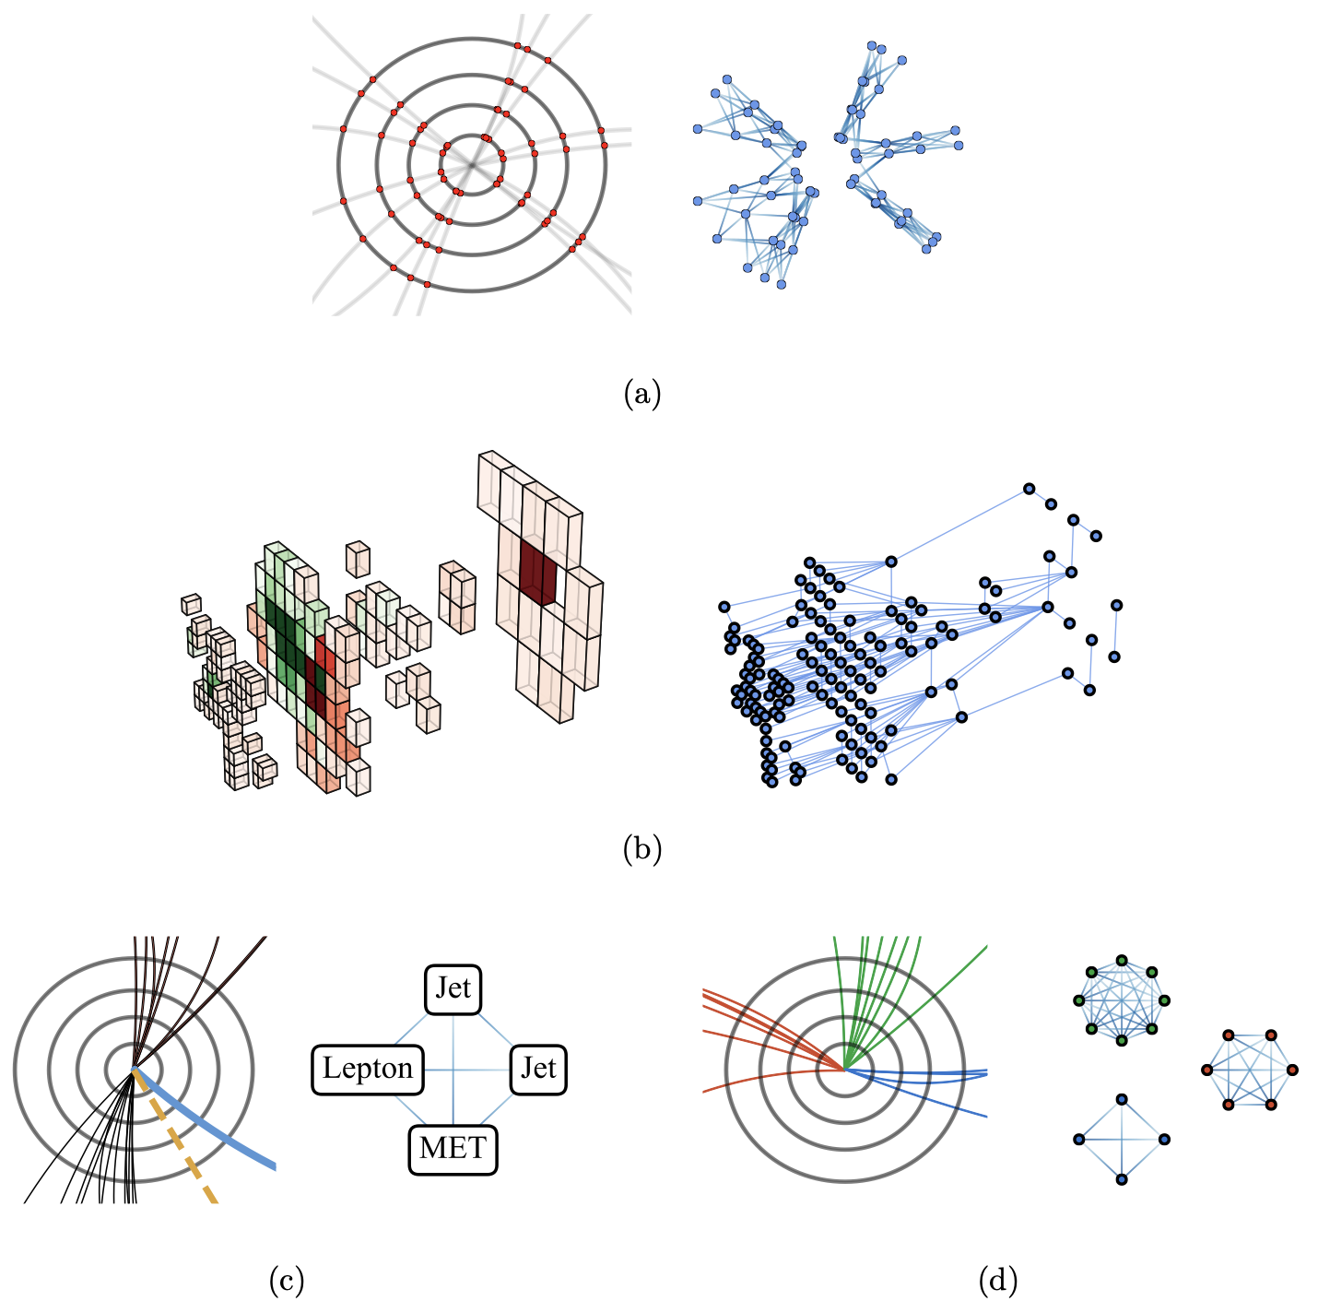
Example: Application in Particle Physics
ML used in particle physics experiments for quite some time, e.g., for signal classification in detector measurements
but usual ML methods often require unnatural data representations
many problems graph-like → GNN
many applications (review), e.g.,
jet reconstruction and classification
classification of astrophysical neutrinos
source

Slide 35
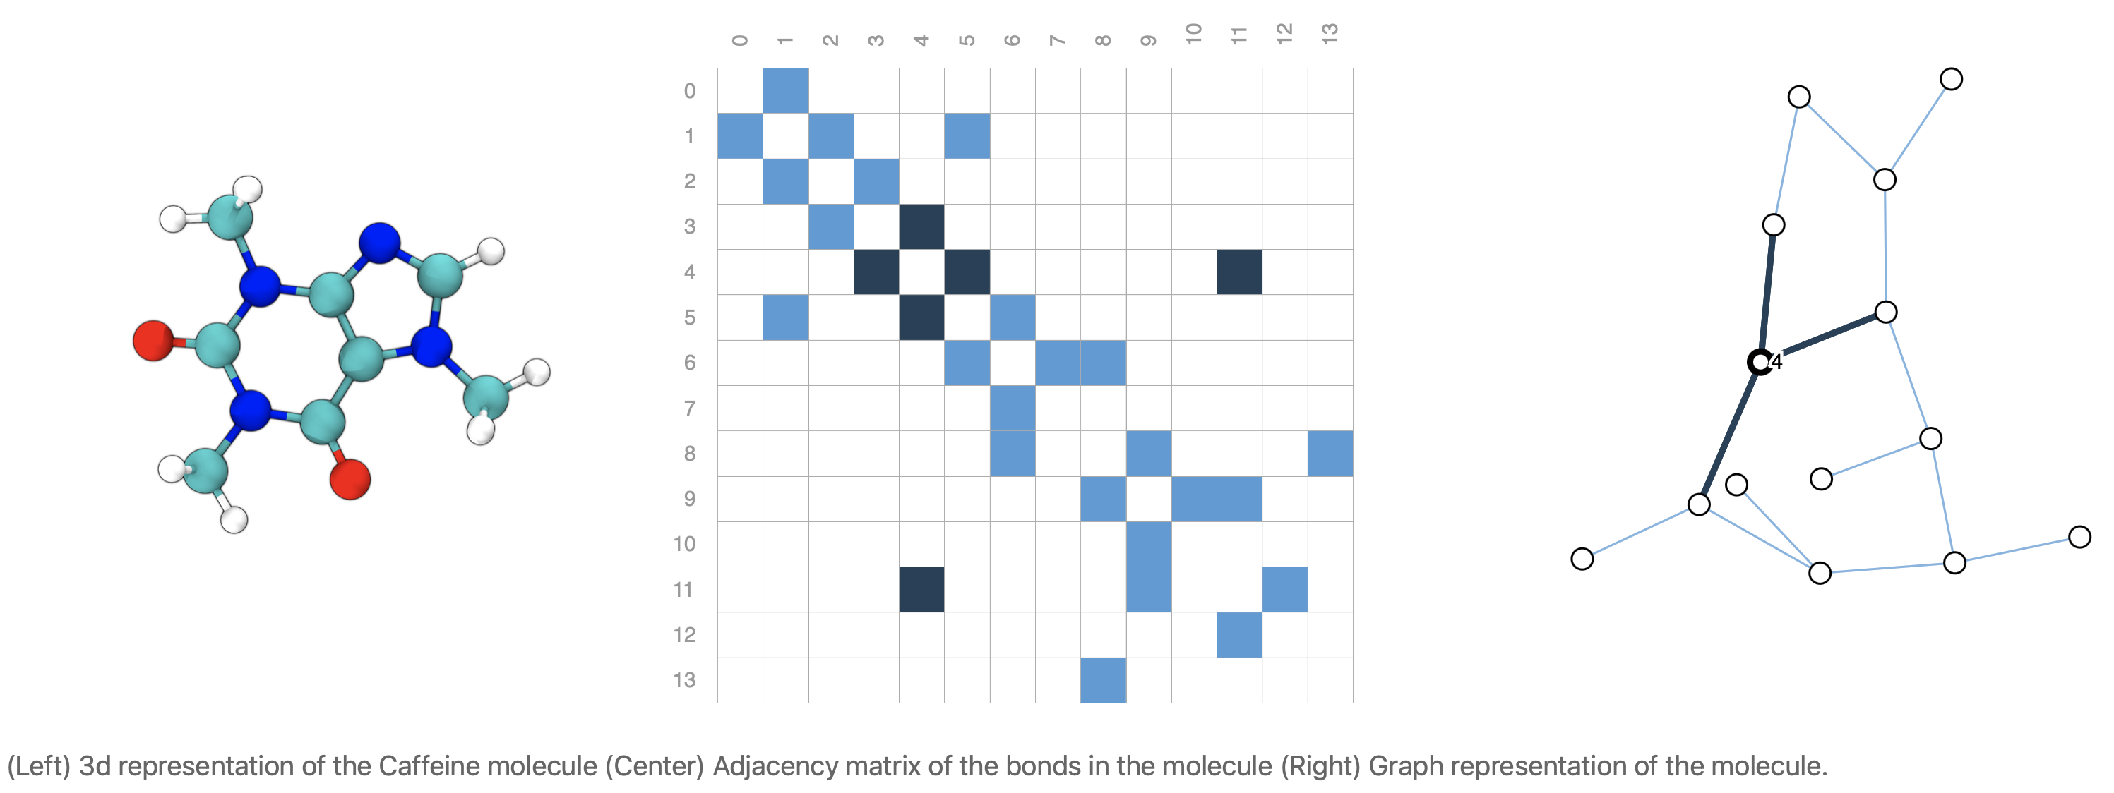
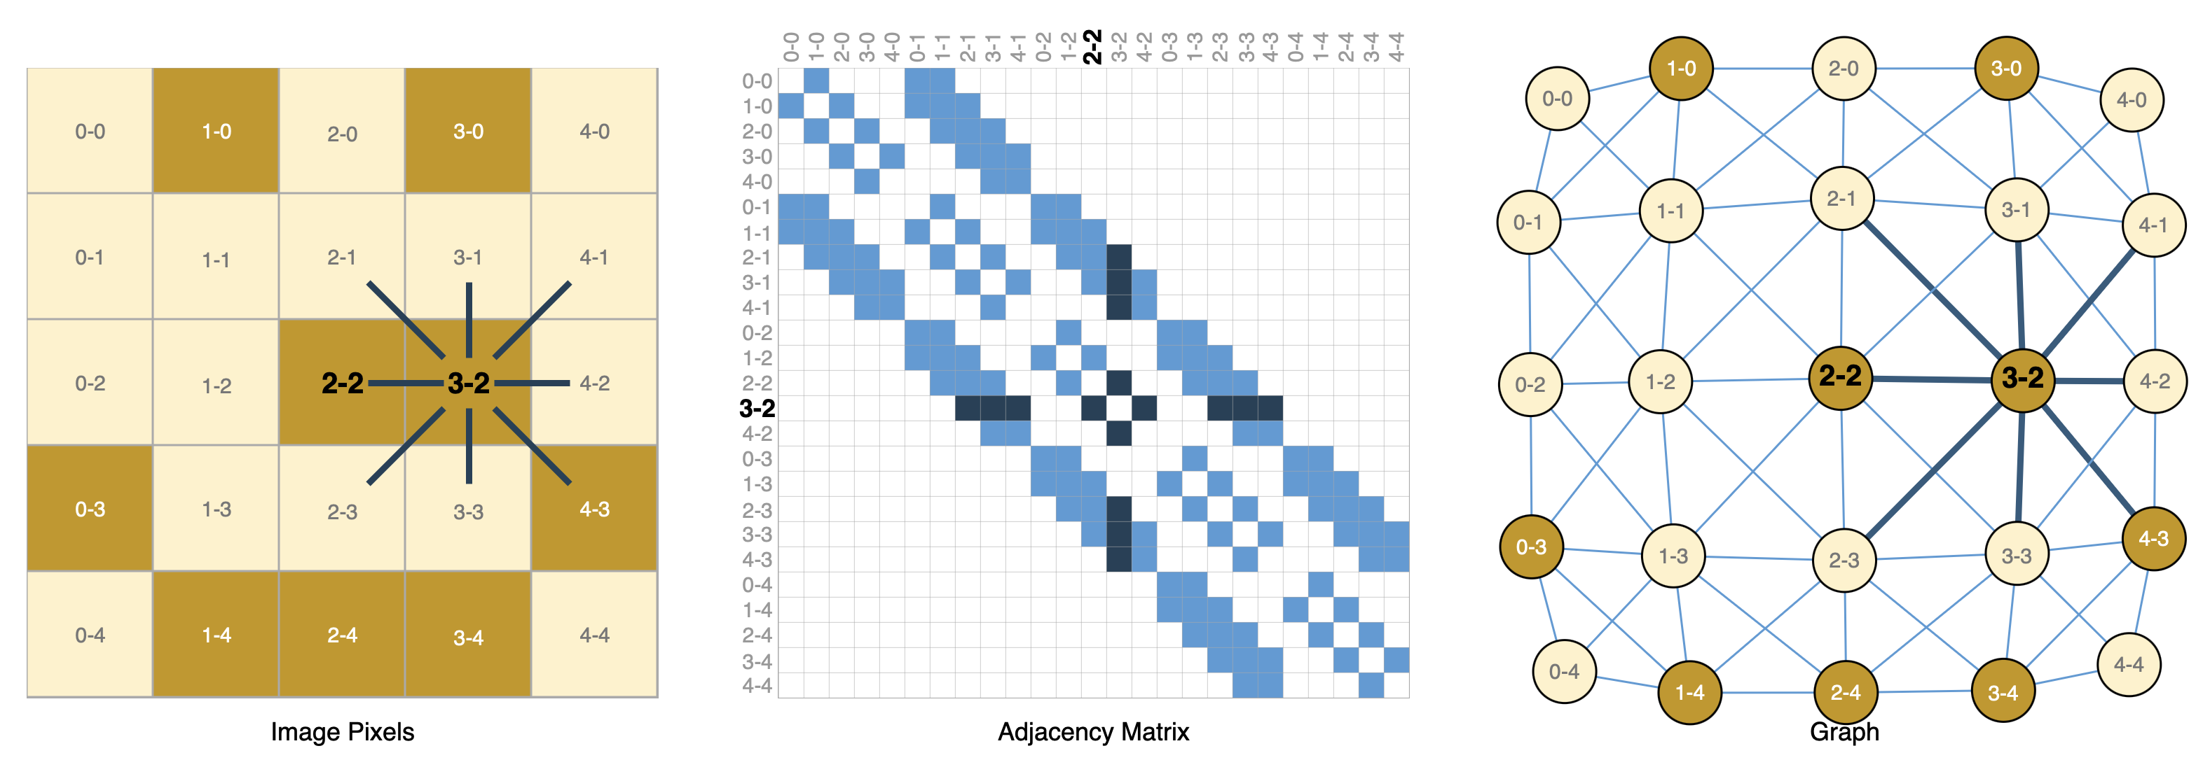
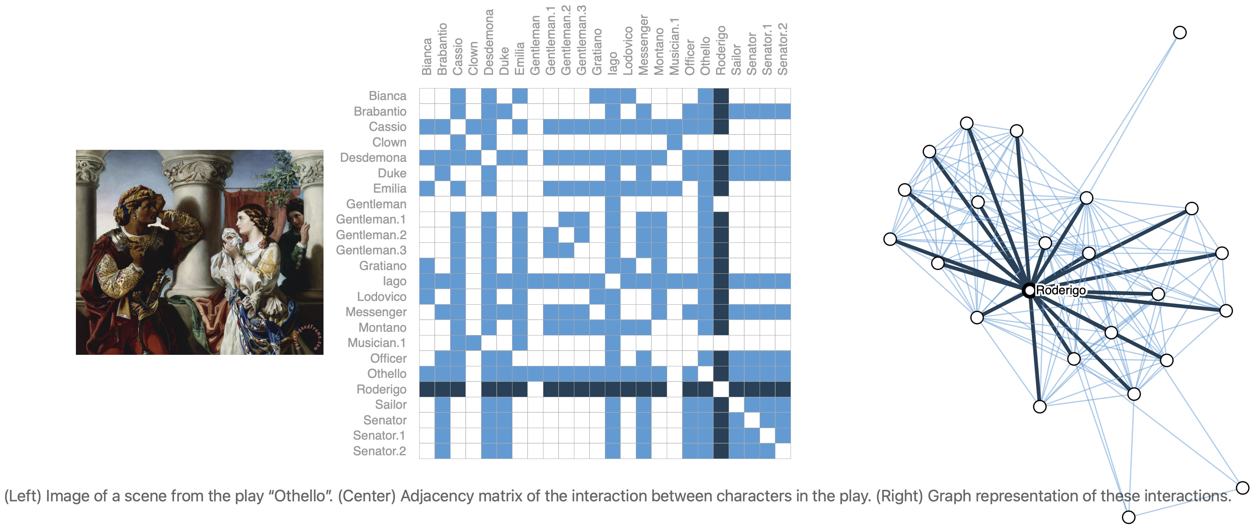
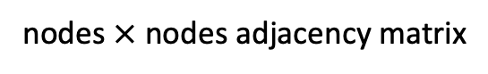
Graph Data
graphs: molecules or social networks, but also images or text
nodes $×$ nodes adjacency matrix
all taken from this nice introduction to GNNs

Slide 36
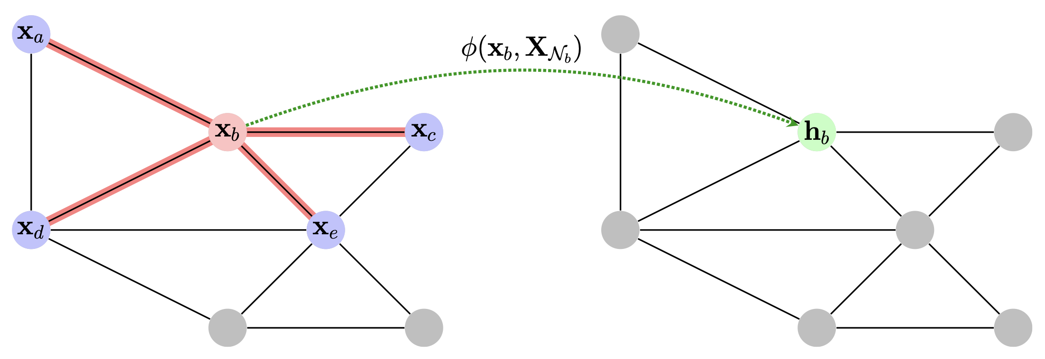
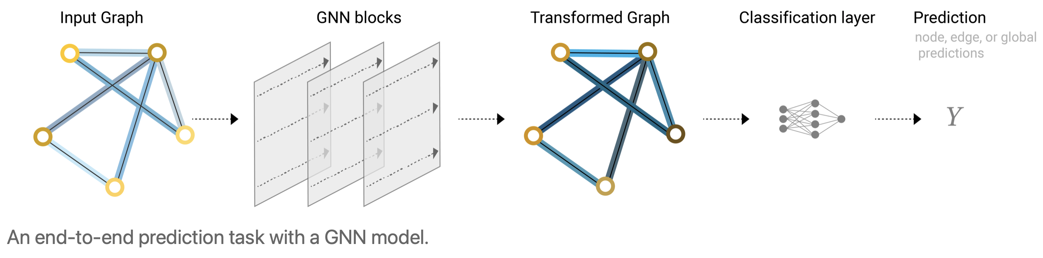
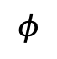
Neural Networks on Graph Data
graph can be specified with adjacency matrix and node (vertex), edge (link), and global attributes/features (learned as representation, e.g., embeddings)
GNNs: neural networks operating on graph data
source
$$φ$$
different tasks:
graph-level: predict property of entire graph (e.g., molecule binding to receptor or labeling of image)
node-level: predict the identity of nodes (e.g., image segmentation)
edge-level: e.g., image scene understanding
source
global pooling layer: aggregation of node/edge representations (can also be node/edge predictions via adjacency instead of global one)

Slide 37
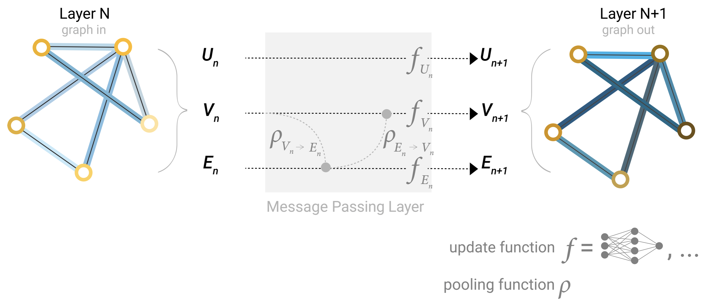
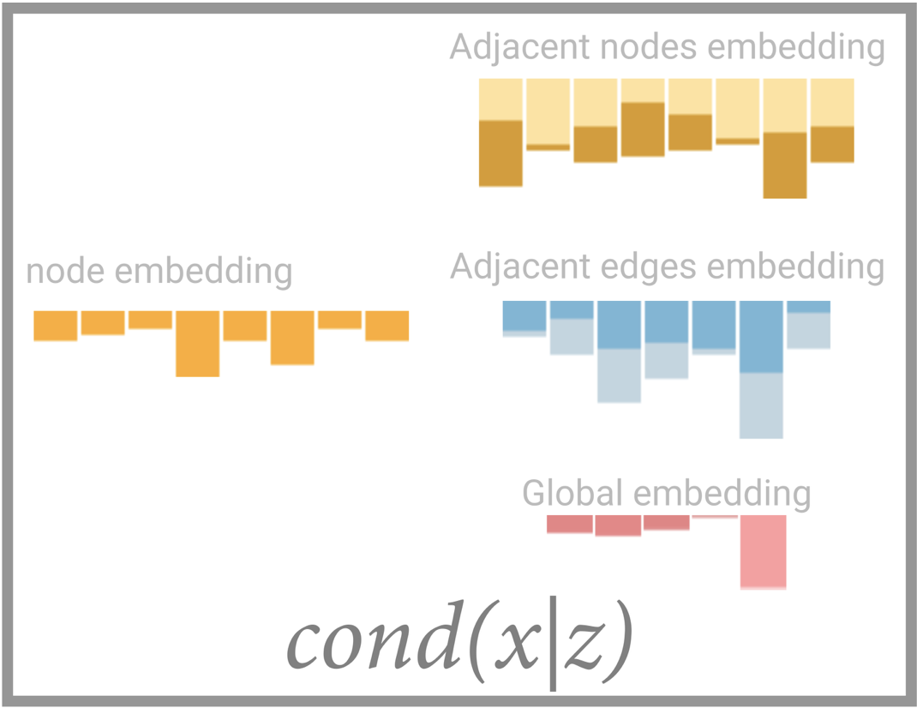

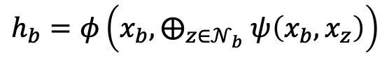
GNN Layers and Message Passing
updating node, edge, and global-context representations by message passing
each message passing layer corresponds to one hop in graph
→ need for lots of stacking to reach full graph
→ add global representation $U$ (context vector) connected to all nodes and edges
$$h_{b}=φ\left(x_{b},⨁_{z∈𝒩_{b}} ψ\left(x_{b},x_{z}\right)\right)$$
attributes
with learnable parameters
source

Slide 38
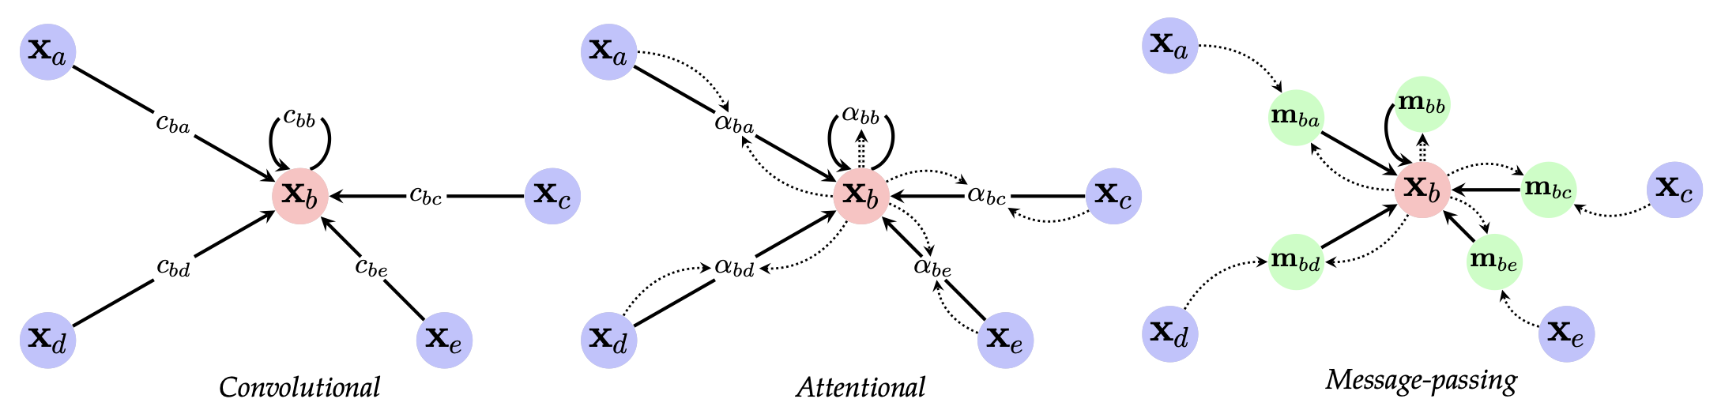
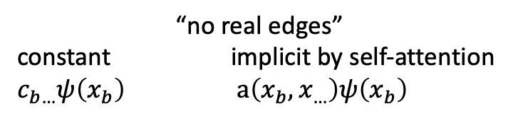
Different Types of GNN Layers
“no real edges”
constant implicit by self-attention
$c_{b…}ψ\left(x_{b}\right)$ $a\left(x_{b},x_{…}\right)ψ\left(x_{b}\right)$
convolutional special case of attentional GNN layers
both convolutional and attentional special cases of message passing GNN layers
source
GNNs very general deep learning architecture: most other architectures special cases of GNNs with additional geometric structure (i.e., different inductive biases)
e.g., transformers in NLP operating over complete graph of words

Slide 39
The Bigger Picture: Symmetries
idea of Geometric Deep Learning (borrowed from geometry):
derive different inductive biases and network architectures from symmetries and invariances
CNN from translation invariance of convolutions
GNNs from permutation invariance of graph nodes:
need for permutation-equivariant GNN layers with permutation-invariant aggregations (e.g., element-wise sum)

Slide 40
Link to Causality
neural causal models: connect SCMs and neural networks (gradient descent)
one step further: connection between SCMs and GNNs

Slide 41


Literature
gentle but geniune introduction, including most ideas:
… and with a little bit more maths ☺:

Slide 42
Fictional Thinking
fictional thinking (imagination of non-existent things) drastically improved human’s communication and collaboration abilities (see Sapiens: A Brief History of Humankind from Harari)
counterfactual causal reasoning as base of human’s fictional capabilities
enrich ML with causality:
not only important for long-term goal of human-level AI
also enabling better human-AI interaction (common causal language)

